Slide 1
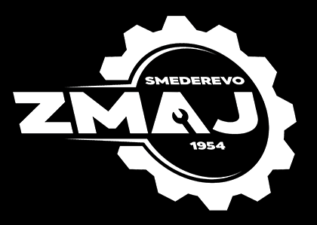

Slide 2
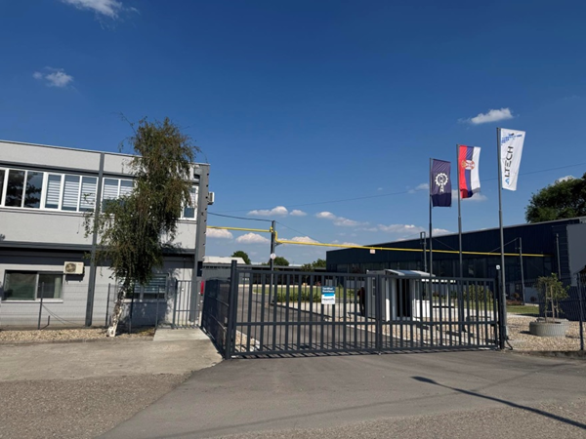
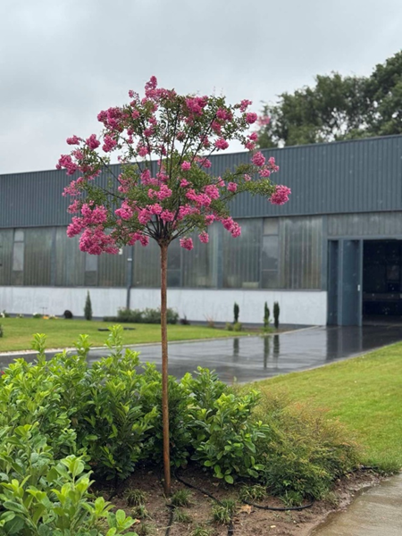
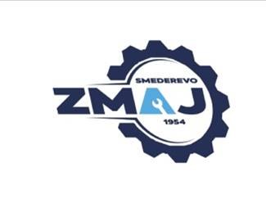
Zmaj d.o.o. is located in Smederevo, in Serbia, on the river Danube, close to the main road, highway, port and railway transshipment point.
Company is located at the very beginning of the industrial zone, and within the Smederevo Free Zone (there are a number of benefits for the company's business with foreign countries).

Slide 3
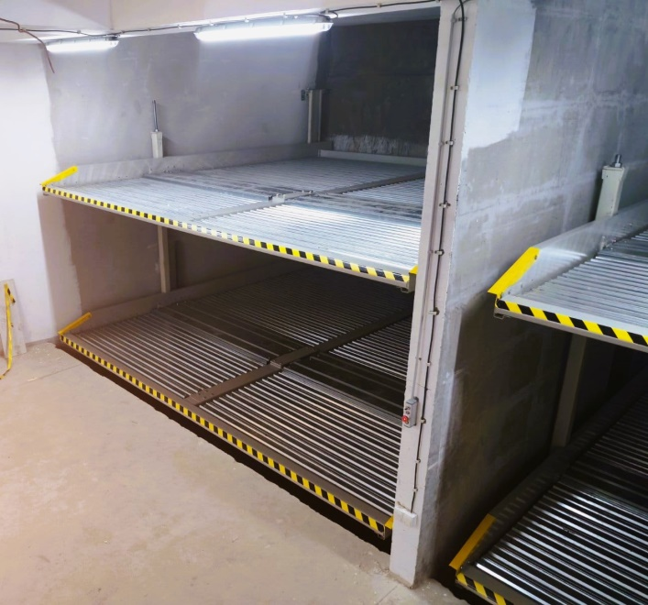
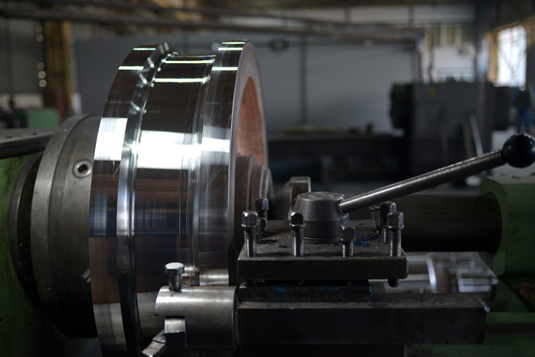
Our company can offer you the services of repair welding due to the wear of rolls and rollers, crane wheels, components of construction machines ... using world-renowned technology.
We have more than 70 years of experience.
By introducing innovations and research, we follow world trends and improve the quality of our products and services.
We also manufacture parking spaces with space-saving hydraulic parking systems.

Slide 4
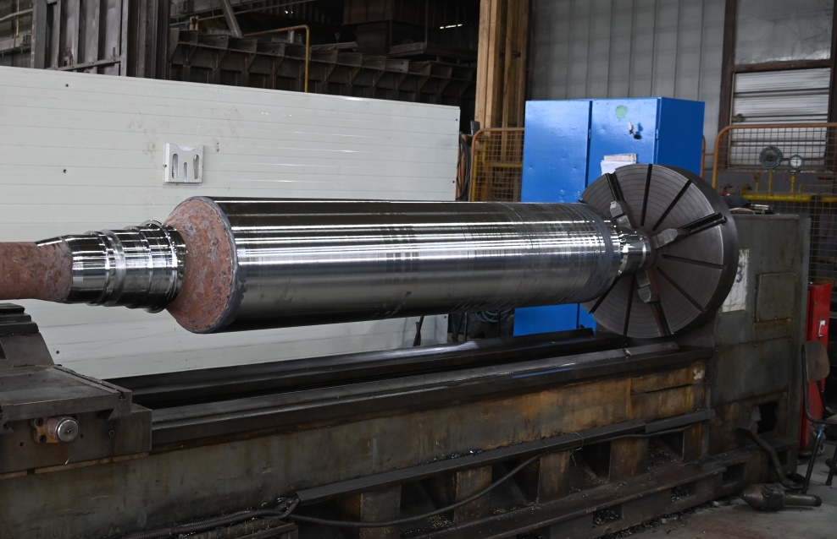
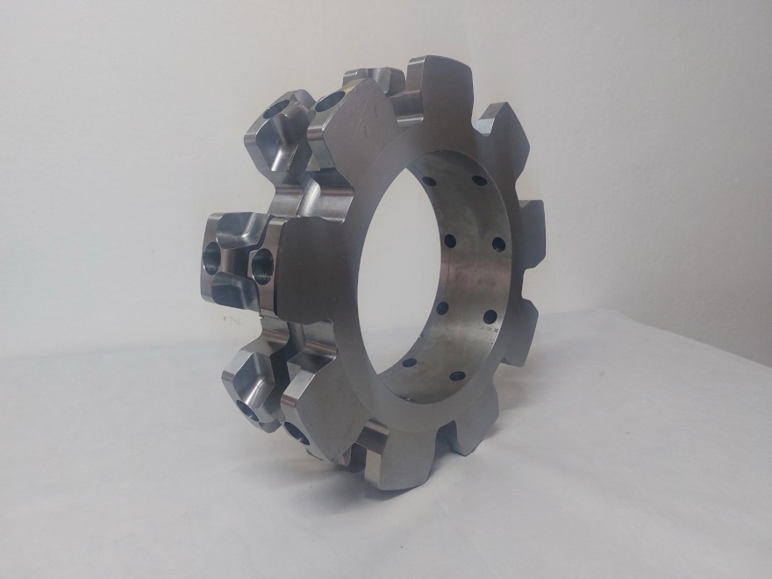
Our main products:
Repair welding (rollers, crane wheels, components of construction machines)
Heat treatment (annealing and normalizing)
Precision Machining of parts
Production of metal structures and assemblies
Hydraulic parking systems

Slide 5
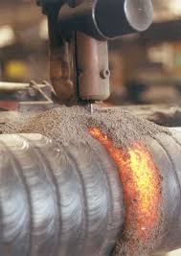
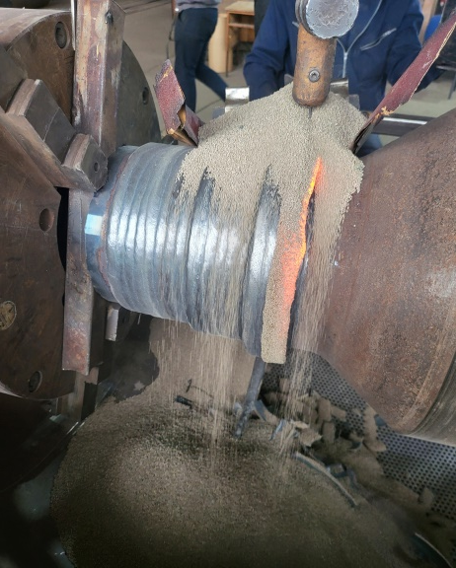
Repair welding
Hardfacing and surfacing parts have greater wear resistance than new ones and a longer service life.
Surfacing is a technique of applying a layer of metal to the surface of another metal object to increase its resistance to fraying, corrosion or erosion, and is often used for repair or parts fabrication. The goal is to improve or obtain desired characteristics (such as greater hardness or heat resistance) on the work surface, and is performed by methods similar to welding, often with preheating or post-heat treatment for optimal results.
Surfacing can also be applied to new parts in order to significantly increase their wear resistance and lifespan.

Slide 6
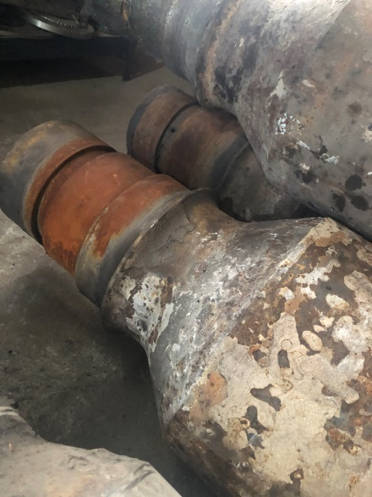
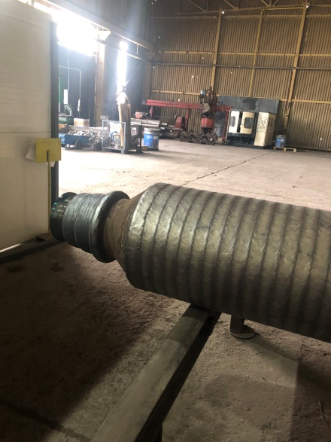
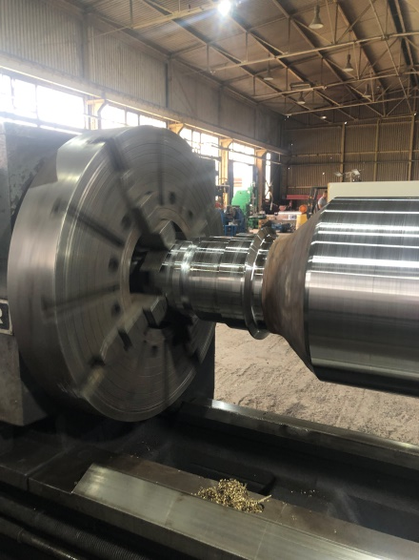
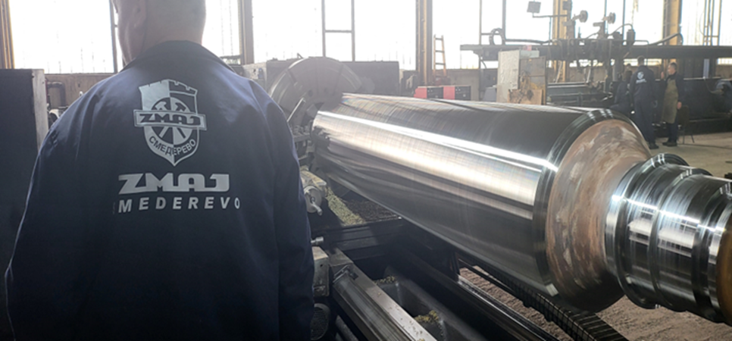
Worn roller Processed roller Final processing
The process is technically similar to welding, but differs in purpose - hardfacing focuses on the surface layer, not the joint of two parts like welding process.
Ready for delivery

Slide 7
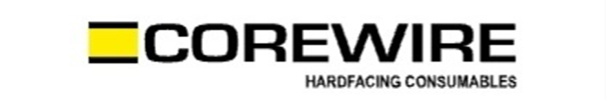
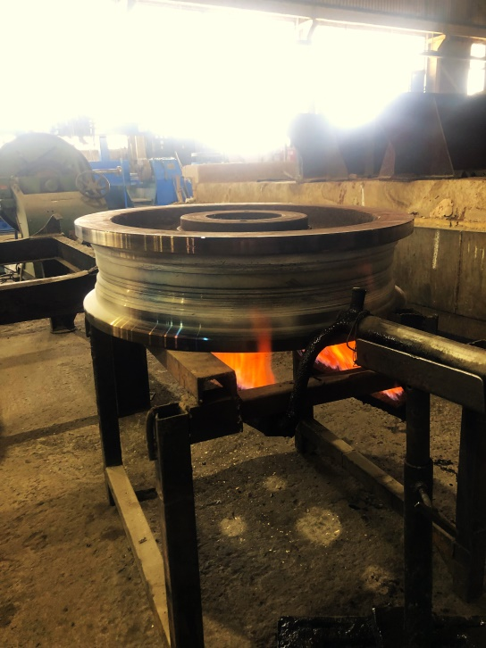
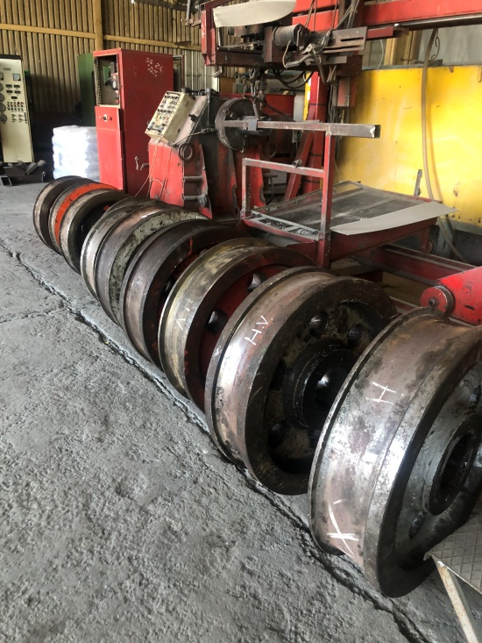
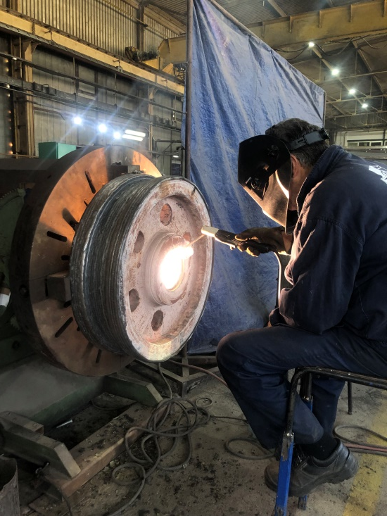
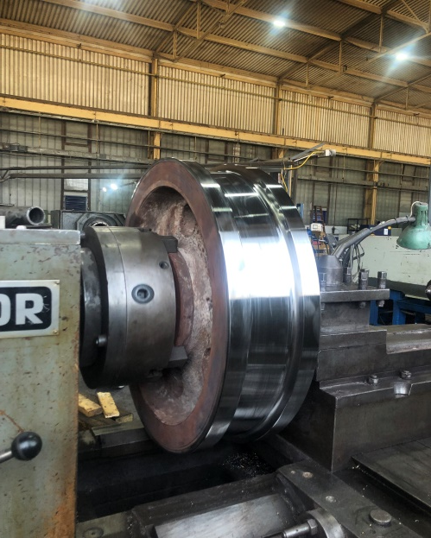
Restoration and reinforcement crane wheel using Corewire material.
The main objective is to increase resistance to various forms of damage, such as abrasion, impacts, erosion or corrosion.
It is often used to repair worn machine elements, returning them to their original functionality.

Slide 8
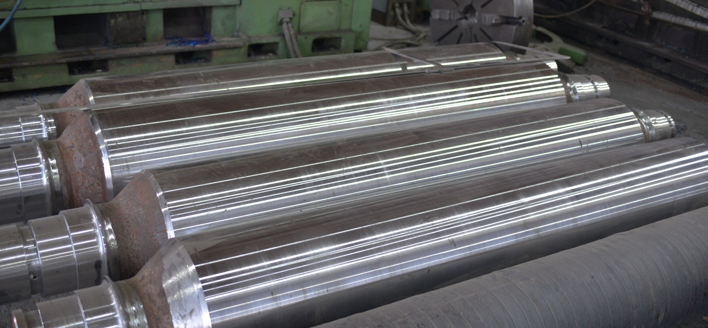

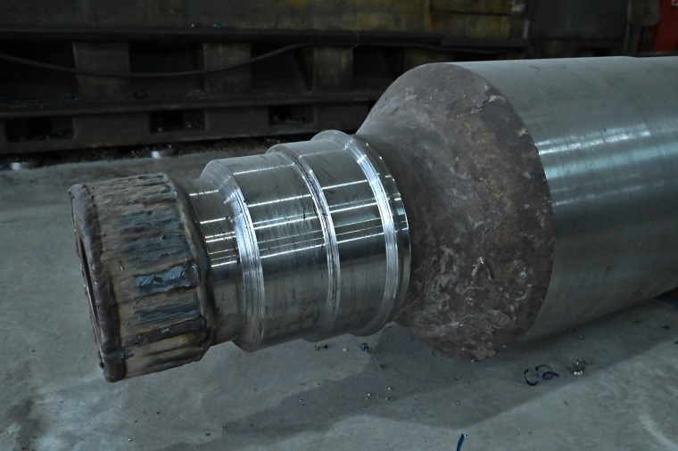
Reference
HBIS - Ironworks

Slide 9
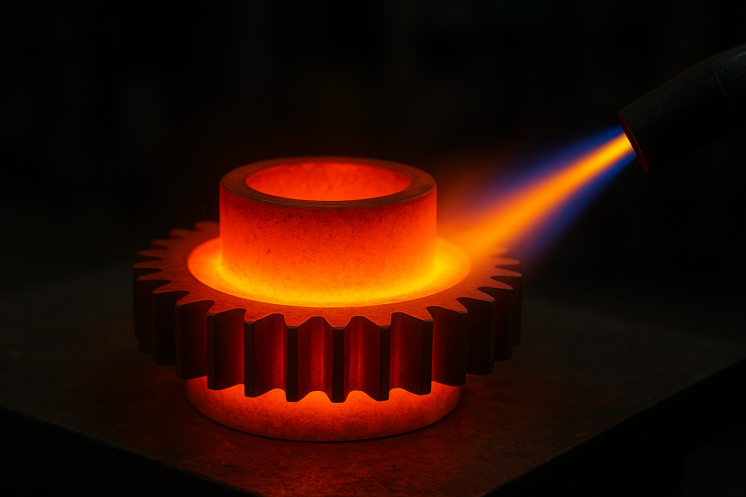
Heat treatment
Annealing
Annealing is a heat treatment of metal, most often steel, which involves heating it to a certain temperature, holding it at that temperature, and slowly cooling it.
The purpose of annealing is to soften the material for easier mechanical processing.
Removes residual stresses that occur as a result of previous processes such as rolling, forging or tempering.
Materials are also prepared for subsequent steps of thermal or mechanical processing.

Slide 10
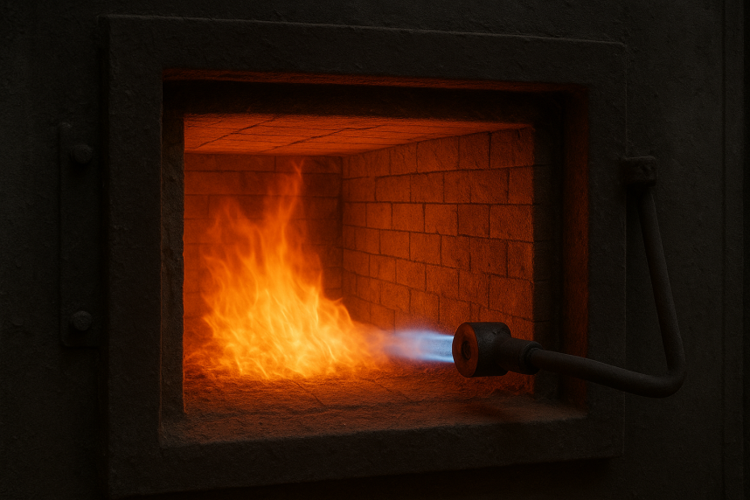
Normalizing
Normalizing is a thermal treatment of steel that improves its toughness and strength, while removing internal stresses.
The steel is heated to a temperature of 30-50 °C above the Ac3 temperature, held at that temperature for a certain time, and then cooled in air.
As a result of that process we get: Improved toughness (and greater resistance to breaking).
Refined steel grain.
Internal stresses removed.
Increased hardness and reduced plasticity.
The purpose of such processing is to prepare the material for further processing, improve mechanical properties, especially in castings and forgings, and improve cutting performance.

Slide 11
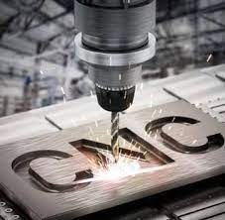
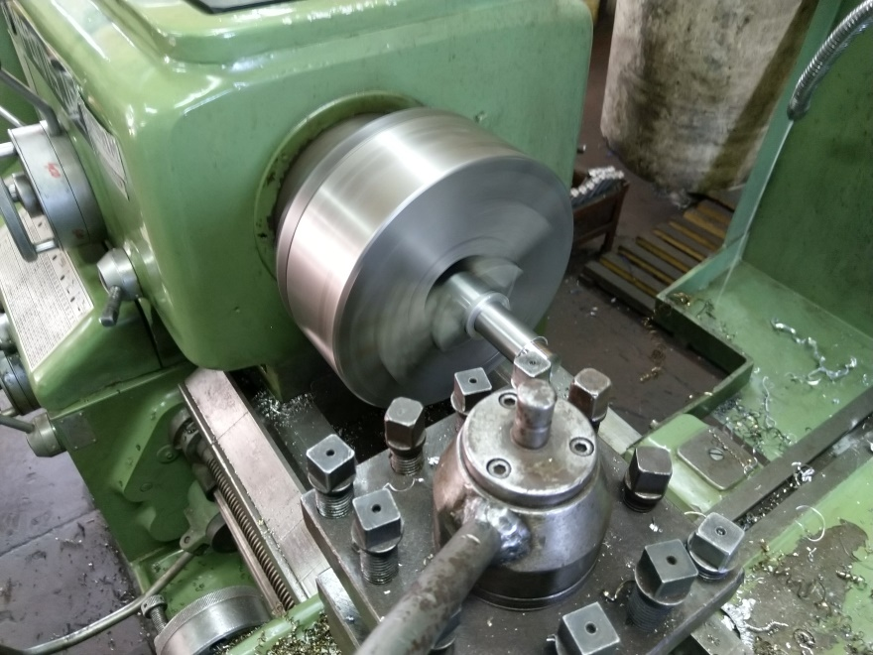
Precision Machining of parts
High-precision processing using CNC and conventional machines.
Serial and individual production of parts.
We are equipped to produce parts according to technical documentation or samples.

Slide 12
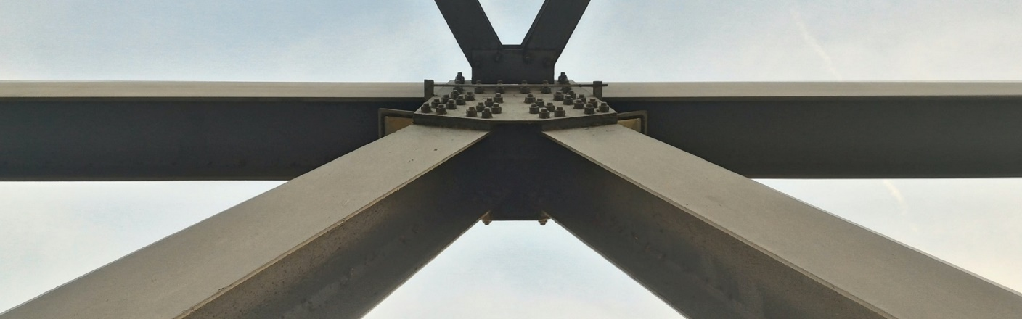
Production of metal structures and assemblies
Metal constructions are made by joining basic elements into one whole.
Connecting is usually done by welding or screws and various elements are used such as pipes, profiles, sheets, etc.

Slide 13
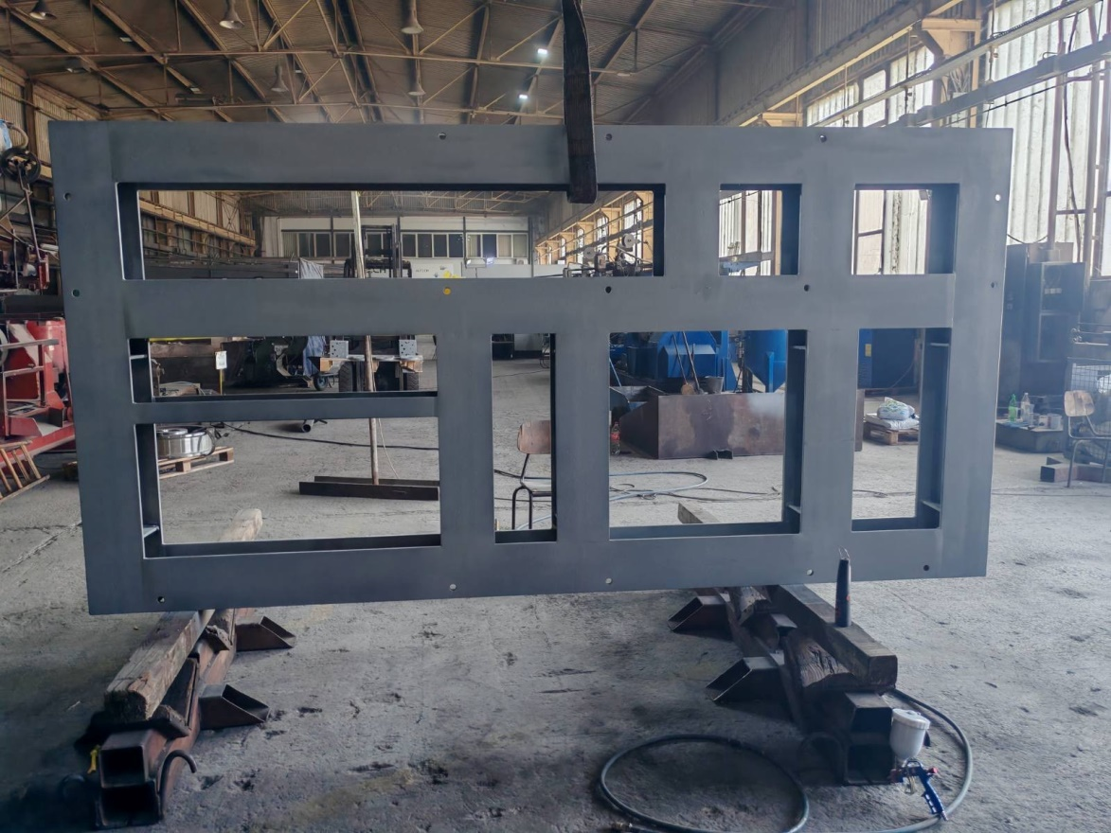
Reference
Mayekawa – Main assembly

Slide 14
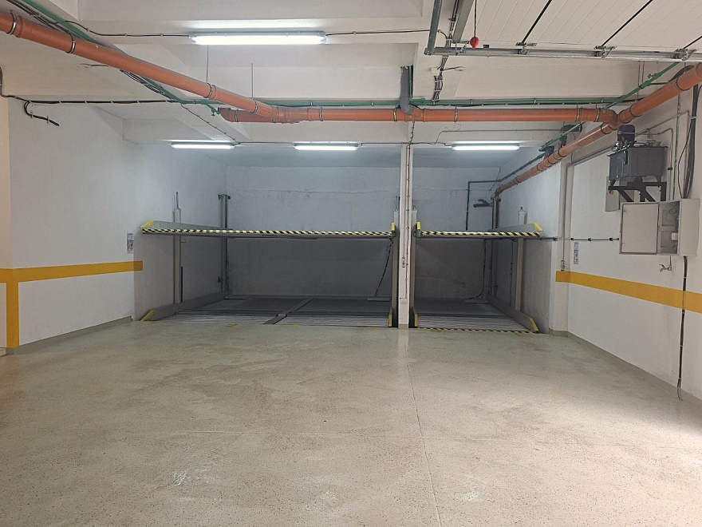
Hydraulic parking systems
Hydraulic parking systems enable modern solutions to problems and easy parking in crowded city centers.
We manufacture and install parking systems for cars.

Slide 15
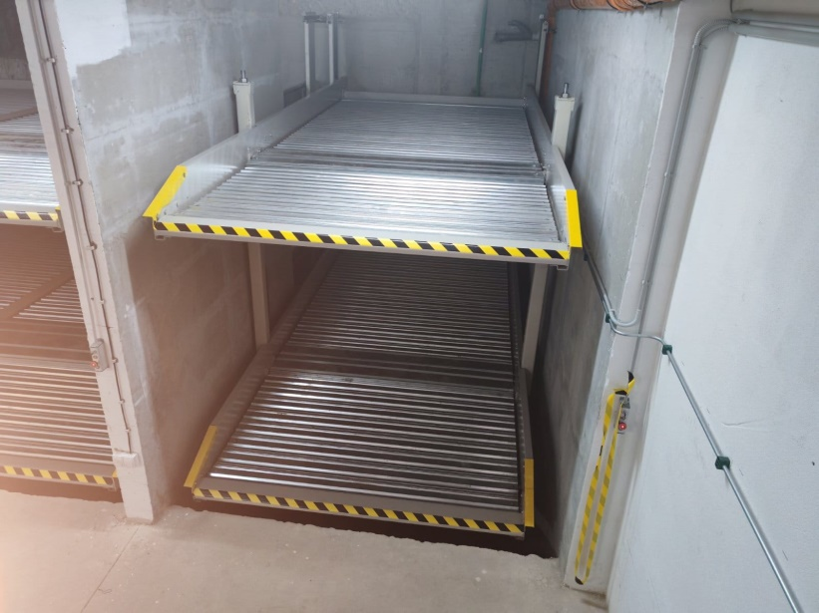
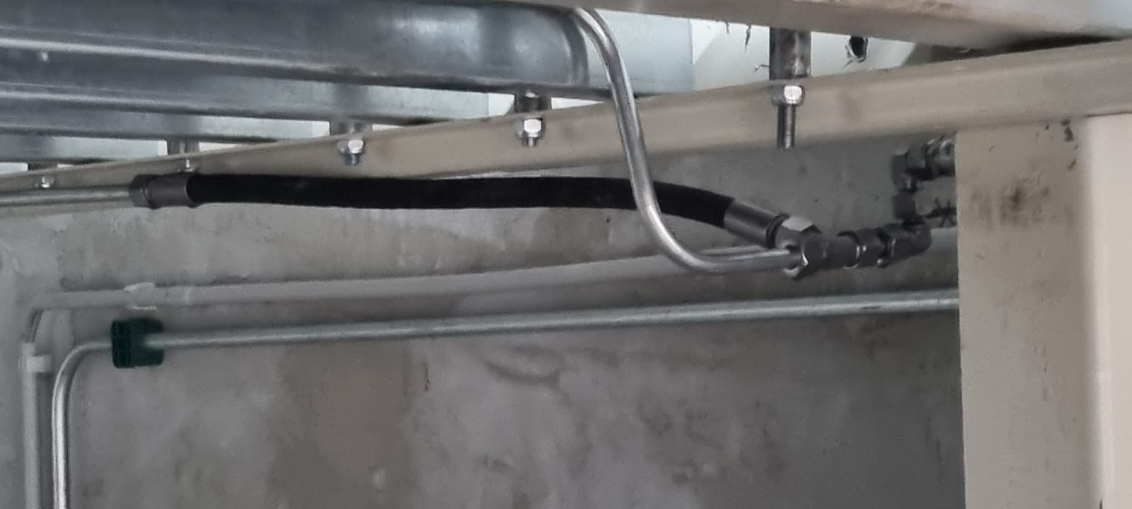
They are made to measure, the most possible use of space, 2.500 kg platform load.
We offer single units for parking two cars in two levels (one car up - one car down) on the surface normally occupied by one car.
We offer double units for parking four cars in two levels (two cars up – two cars down) on the surface normally occupied by two cars.

Slide 16
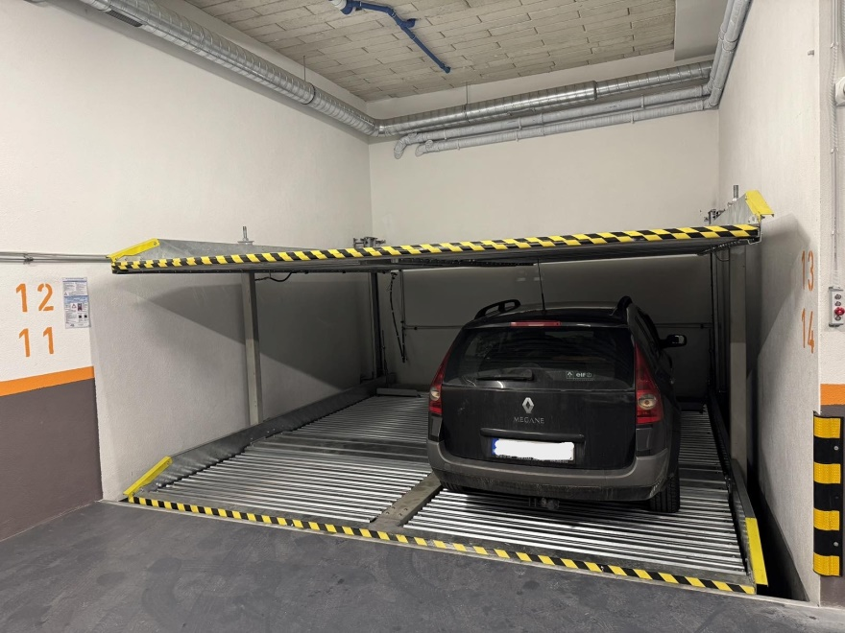
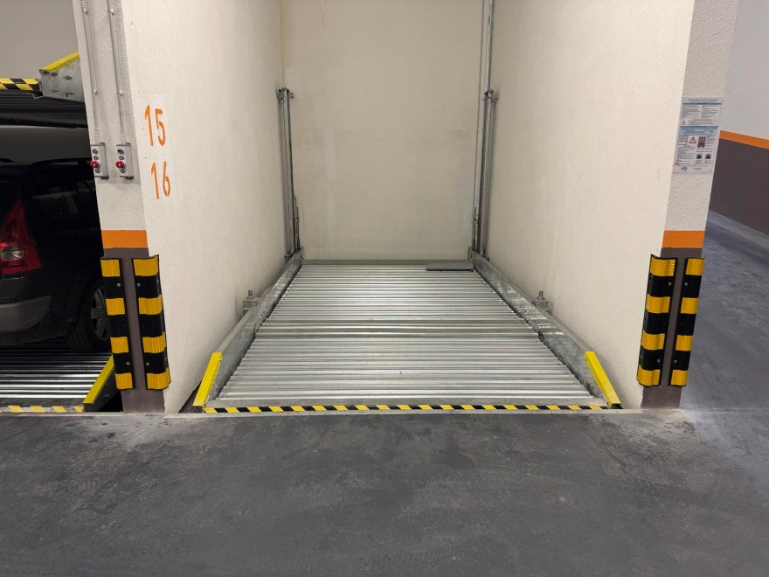
They are designed for installation in pits, usually in underground garages where the height of the space and the depth of the pit in which they are installed are limited.
Ease of installation, use, and maintenance make it very suitable for installation in underground garages.
This system does not require additional construction work.

Slide 17



Visions and goals of our company
Working better for the well-being of the employees and the satisfaction of users
To remain the market leader in regards to the quality of products from the field of our activity
Constantly using innovations to improve our products

Slide 18
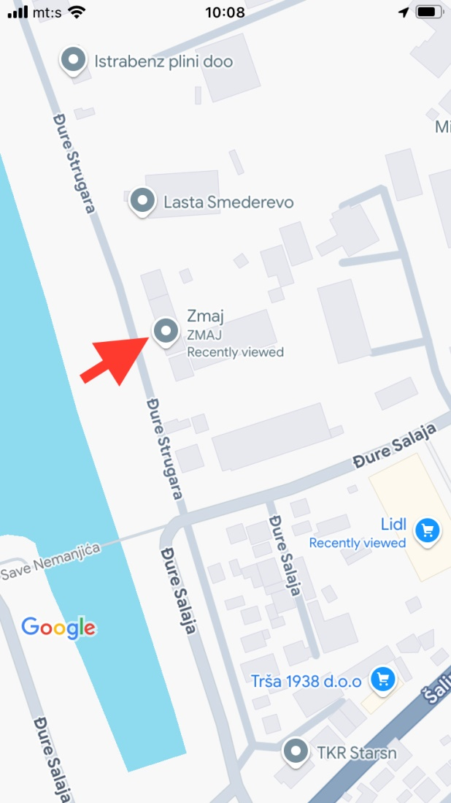
Đure Strugara no. 16
11 300 Smederevo
Serbia
Phone number:
+38163289508
E-mail:
zmaj@zmaj.rs
office@zmaj.rs

